Slide 1
CSCF ANNUAL BUDGET: July 1, 2022 – June 30, 2023

Slide 2
Agenda
Full-Year Budget 2022-2023
Budget Strategic Priorities and Goals
Compensation Statistics and Cost
General & Administrative
Summary

Slide 3
Budget overview
 |  | FY 2022-23 | FY 2021-22 | $ Difference | % Difference
Reserves From Prior Year |  | $28,362,798 | $11,453,123 | $16,909,675
Current Year Funding Allocation - DEO |  | $26,409,937 | $40,741,305 | ($14,331,368)
Current Year Funding Awards - Non-DEO |  | $3,500,000 | $11,168,370 | ($7,668,370)
Award Total - Available Funds |  | $58,272,735 | $63,362,798 | ($5,090,063)
LESS planned Carryover For FY 23 - 24 |  | ($14,272,735) | ($21,362,798) | $7,090,063
Total Available Funds Budgeted |  | $44,000,000 | $42,000,000 | $2,000,000 | 4.8%
A
B
Note A: Standard annual allocations from DEO was $28.2M. An additional $12.5M was received special grants awarded by DEO and CareerSource FL.
Note B: Actual projected expenditures for FY2021-22 is $35M. The balance of $7M is reflected in the “Reserves From Prior Year” category for FY2022-23.

Slide 4
Revenue sources - $44M
DEO ALLOCATIONS
WIOA Adult | $5,125,162
WIOA Youth | $5,096,801
WIOA Dislocated | $4,975,316
Wagner Peyser | $2,405,542
Welfare Transition | $7,789,115
SNAP | $610,000
VETS | $252,315
Re-employment Assistance | $771,930
Other | $1,067,732
Total DEO Allocations | $28,093,914
Workforce Innovation Opportunity Act (WIOA)
Includes WIOA Grant Funding
The balances represent revenue projections for one fiscal year. Note, several grants have multi-year allocations.

Slide 5
CSCF Budget Allocation: Full Year 2022 – 2023
$44M
Budget Allocations |  | Budget |  |  | % of Expenditure
Talent and Recruitment Solutions
Career Consultants |  | 12,638,828 |  |  | 28.7%
Business Consultants |  | 2,161,103 |  |  | 4.9%
Temporary Staffing (Supporting Summer Youth) |  | 500,000 |  |  | 1.1%
Training Investment |  | 14,000,000 |  |  | 31.8%
Career Seekers Support & Incentives |  | 1,200,000 |  |  | 2.7%
Contracted Services |  | 2,885,000 |  |  | 6.6%
Facilities, Maintenance & Related Cost |  | 2,400,000 |  |  | 5.5%
Total Talent and Recruitment Solutions |  | $ 35,784,931 |  |  | 81.3%
General Support Cost
Staff Supporting Operations |  | 4,743,113 |  |  | 10.8%
Strategic Communications |  | 800,000 |  |  | 1.8%
Staff Development (CareerSourcers) |  | 445,000 |  |  | 1.0%
IT Cost/Network Expenses |  | 1,452,000 |  |  | 3.3%
Facilities, Maintenance & Related Cost |  | 325,000 |  |  | 0.7%
G&A Professional Services |  | 450,000 |  |  | 1.0%
Total General Support Cost |  | $ 8,215,069 |  |  | 18.7%
TOTAL EXPENDITURES |  | $ 44,000,000 |  |  | 100.0%
TALENT & RECRUITMENT SOLUTIONS
$ 35,784,931 | 81.3%
GENERAL SUPPORT COST
$ 8,215,069 | 18.7%

Slide 6
CSCF Budget Allocation: year-over-year comparison
Budget Allocations |  | FY 2022/23 | FY2021/22 | DIFFERENCE
Talent and Recruitment Solutions |  | A | B | A - B
Career Consultants |  | 12,638,828 | 10,500,581 | 2,138,247
Business Consultants |  | 2,161,103 | 2,013,774 | 147,329
Temporary Staffing |  | 500,000 | 500,000 | -
Training Investment |  | 14,000,000 | 17,000,000 | (3,000,000)
Career Seekers Support & Incentives |  | 1,200,000 | 1,200,000 | -
Contracted Services |  | 2,885,000 | 365,000 | 2,520,000
Facilities, Maintenance & Related Cost |  | 2,400,000 | 2,784,354 | (384,354)
Total Talent and Recruitment Solutions |  | $ 35,629,931 | $ 34,363,709 | $ 9,510,715
General Support Cost
Staff Supporting Operations |  | 4,743,113 | 4,200,918 | 542,151
Strategic Communications |  | 800,000 | 500,000 | 300,000
Staff Development (CareerSourcers) |  | 445,000 | 405,000 | 40,000
IT Cost/Network Expenses |  | 1,452,000 | 1,587,000 | (135,000)
Facilities, Maintenance & Related Cost |  | 325,000 | 493,373 | (168,373)
G&A Professional Services |  | 450,000 | 450,000 | -
Total General Support Cost |  | $ 8,215,069 | $ 7,636,291 | $ 989,285
TOTAL EXPENDITURES |  | $ 44,000,000 | $ 42,000,000 | $ 2,000,000

Slide 7
CSCF Budget Allocation: DIRECT PROGRAM VS. ADMIN COST
$44M
Budget Allocations |  | Budget |  |  | % of Expenditure
Talent and Recruitment Solutions
Career Consultants |  | 14,991,106 |  |  | 34.1%
Business Consultants |  | 2,161,103 |  |  | 4.9%
Temporary Staffing (Supporting Summer Youth) |  | 500,000 |  |  | 1.1%
Training Investment |  | 14,000,000 |  |  | 31.8%
Career Seekers Support & Incentives |  | 1,200,000 |  |  | 2.7%
Contracted Services |  | 2,885,000 |  |  | 6.6%
Strategic Communications |  | 800,000 |  |  | 1.8%
Staff Development (CareerSourcers) |  | 311,500 |  |  | 0.7%
IT Cost/Network Expenses |  | 1,306,800 |  |  | 3.0%
Facilities, Maintenance & Related Cost |  | 2,400,000 |  |  | 5.5%
Total Talent and Recruitment Solutions |  | $ 40,555,509 |  |  | 92.2%
Administrative Cost
Staff Supporting Operations |  | 2,390,791 |  |  | 5.4%
Staff Development (CareerSourcers) |  | 133,500 |  |  | 0.3%
IT Cost/Network Expenses |  | 145,200 |  |  | 0.3%
Facilities, Maintenance & Related Cost |  | 325,000 |  |  | 0.7%
G&A Professional Services |  | 450,000 |  |  | 1.0%
Total Administrative Cost |  | $ 3,444,491 |  |  | 7.8%
TOTAL EXPENDITURES |  | $ 44,000,000 |  |  | 100.0%
TALENT & RECRUITMENT SOLUTIONS
$ 40,555,509 | 92.2%
ADMINISTRATIVE COST
$ 3,444,491 | 7.8%

Slide 8
BUDGET STRATEGIC PRIORITIES AND GOALS

Slide 9
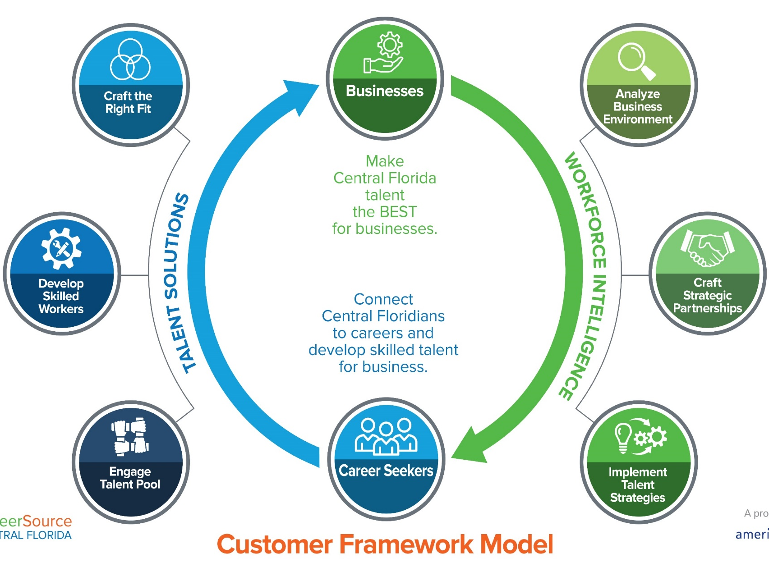
CSCF STRATEGIC PRIORITIES
DIVERSIFY REVENUE STREAMS TO ADJUST FOR VARIABLES IN FEDERAL FUNDING
DELIVER TALENT ACQUISITION STRATEGIES FOR BUSINESSES IN RECOVERING & EMERGING INDUSTRIES
DELIVER TALENT SOLUTIONS TO IGNITE POTENTIAL
ADJUST TO EVOLVING MARKET AND LEGISLATIVE CHANGES THROUGH INNOVATIVE INITIATIVES

Slide 10
2022-2023 Strategy
NORTH STAR
Strategic Priority
Goals
Outcome
DIVERSIFY REVENUE STREAMS TO ADJUST FOR VARIABLES IN FEDERAL FUNDING
Generate $3.5M of New Diversified Revenue
Establish Organizational Structure and Strategy to Generate Non-DEO Revenue
Develop and Activate Plan to Invest General (unrestricted) Revenue
An Increased CSCF Budget/Revenue Stream, Enabling Greater Flexibility in the Delivery
of Services, Stability and Sustainability
Foundational Focus
DELIVER TALENT ACQUISITION STRATEGIES FOR BUSINESSES IN RECOVERING & EMERGING INDUSTRIES
Ensure 60% or greater are Small-Medium Businesses
Deliver Workforce Intelligence As a Core Business Service
Align Business Recruitment Strategies to Meet Market Demands
Quality Recruitment Services to Deliver Qualified Candidates for Interviews and Hiring by Businesses Served
DELIVER TALENT SOLUTIONS TO IGNITE POTENTIAL
Create Value Through Comprehensive Career Services Within the Customer Journey
Central Florida Job Seekers Receive Quality Services Throughout their Career Journey that Result in Increased Skills
and Employment
Positioning For Growth
Track and Define New Legislation as the State Releases New Policies Impacting Service Delivery and Training
Elevate and Innovate the Organization's Capacity to Provide Virtual Services
Establish New Return on Investment Strategies to Measure Market Needs Across the Region
Defined Return on Investment and Use Leveraged Data to Understand Changing Markets
Opportunities for Innovation in Virtual Service Delivery for Customers and Clients
ADJUST TO EVOLVING MARKET AND LEGISLATIVE CHANGES THROUGH INNOVATIVE INITIATIVES

Slide 11
DIVERSIFY REVENUE STREAMS TO ADJUST FOR VARIABLES IN FEDERAL FUNDING
GOAL
Generate $3.5M of New Diversified Revenue
Establish Organizational Structure and Strategy to Generate Non-DEO Revenue
Develop and Activate Plan to Invest General (unrestricted) Revenue
KEY PERFORMANCE METRICS
Achieve Target of $3.15M of New Restricted Non-DEO Revenue
Achieve Target of $350K of New General “Unrestricted” Revenue
Creation of a New Organizational Structure and Operational Plan to Support Non-DEO Revenue
OUTCOME
An Increased CSCF Budget/Revenue Stream, Enabling Greater Flexibility in the Delivery of Services, Stability and Sustainability

Slide 12
Diversified Revenue
Unrestricted Revenue
Restricted Revenue
REVENUE |  | BUDGET
Unrestricted Balance As of April 2022 |  | $ 954,000
Receivables as of April 2022 |  | $ 46,000
* Unrestricted Donations Made to CSCF |  | $ 100,000
*Ticket to Work Projected Revenue (Rounded) |  | $ 250,000
TOTAL PROJECTED REVENUE |  | $ 1,350,000
EXPENDITURES
Operational Cost |  | $ 250,000
Fundraising & Revenue Development |  | $ 100,000
TOTAL PROJECTED EXPENDITURES |  | $ 350,000
PROJECTED BALANCE AT 06/30/23 - (ROUNDED) |  | $ 1,000,000
RESTRICTED REVENUE |  | BUDGET
*TOTAL PROJECTED REVENUE |  | $ 3,150,000
Funding sources include grants, municipalities, business investments and sponsorships
* Diversified Revenue
Ticket to Work Projected Revenue + Unrestricted Donations + Restricted Revenue = $3,500,000

Slide 13
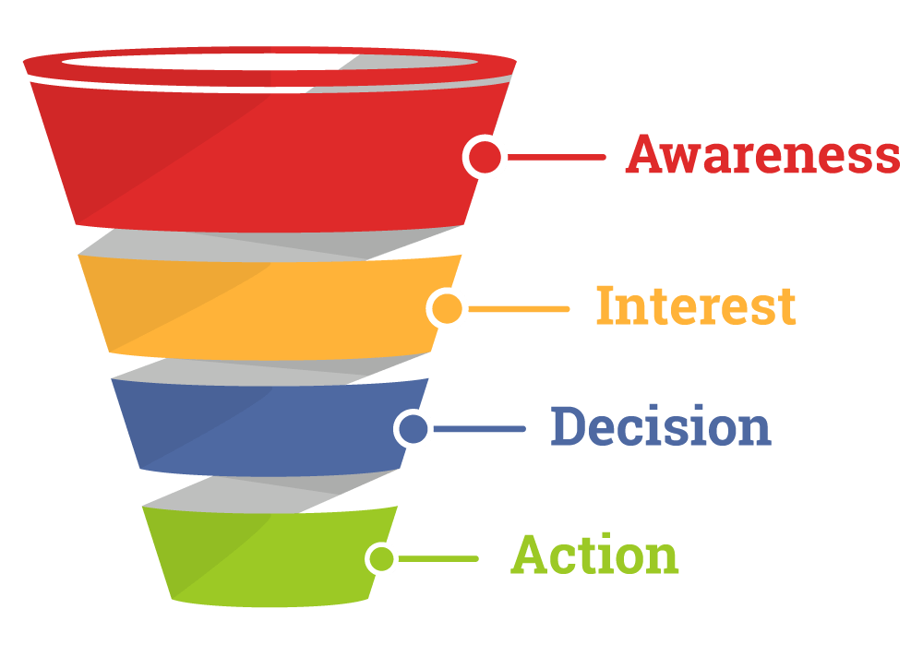
DELIVER TALENT RECRUITMENT & RETENTION INITIATIVES FOR BUSINESSES IN RECOVERING & EMERGING INDUSTRIES
GOAL
Ensure 60% of Businesses Served are Small-Medium Businesses
Deliver Workforce Intelligence As a Core Business Service
Align Business Recruitment Strategies to Meet Market Demands
15,000
Business Leads
KEY PERFORMANCE METRICS
Increase Quality Services to Businesses by 50%
Increase the Number of Businesses Engaged by Dedicated Business Consultants by 20%
Actively Recruit and Refer Twice as Many Qualified Candidates to Business
5,000 Qualified Candidates Interviewed or Hired by Engaged Businesses
8,000
Businesses Served
4,000
Businesses Engaged
5,000
Qualified Candidates to Business
CSCF Provided Quality Recruitment Services and Delivers Qualified Candidates who are Interviewed or Hired by the Businesses Served
OUTCOME
Notes:
Keep slide – Service Delivery

Slide 14
DELIVER TALENT SOLUTIONS TO IGNITE POTENTIAL
GOALS
Create Value Through Comprehensive Career Services Within the Customer Journey
30,000
45,000
Career Seeker
Leads
KEY PERFORMANCE METRICS
30,000
Individuals
Engaged with Staff in Career Services
30,000 Receive Career Services with CSCF Staff
15,000 Receive Career Planning Consultations
3,000 Career Seekers Receiving CSCF Supported Training
Receive Training / Credentials
80% Achieve a Wage of >$17.50
7,500 Employed
15,000
Individuals Provided Career Planning Services
7,500
Individuals Employed
Central Florida Job Seekers Received Quality Services Throughout their Career Journey that Results in Increased Skills and Employment.
OUTCOME
Notes:
Numbers include all programs – DEO, Level Up, Summer
Training Target = 2,500 WIOA+1500 SYEP+2000 LUO= 6000*50% accounting for potential duplication=
SYEP =
Users 3000 = Leads
Applicants 2000 = Engaged
Training Services = 1500

Slide 15
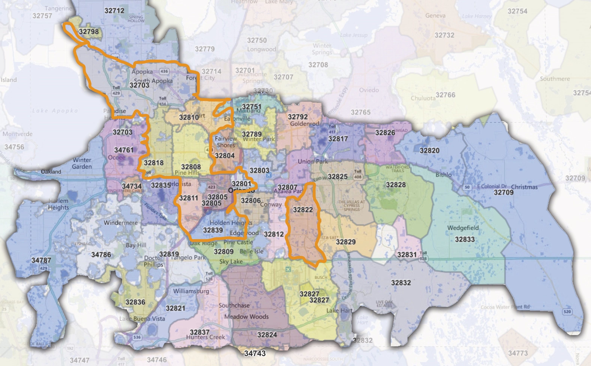
$10.3 million grant from Orange County
Through Dec 2023
COVID-impacted residents with special emphasis on nine low-income zip codes + veterans, justice-involved and people with disabilities
Training scholarships, internships and support funding for high school seniors, adult career-seekers and local businesses
Investment in new outreach, tools and training platforms
Priority neighborhoods: Parramore (32801), Clear Lake (32805), Pine Hills (32808) Lockhart (32810), Orlo Vista (32811), Hiawassee (32818), Apopka (32703), SE Orlando (32822), Edgewood/Pine Castle (32839)

Slide 16
ADJUST TO EVOLVING MARKET AND LEGISLATIVE CHANGES THROUGH INNOVATIVE INITIATIVES
Track and Define New Legislation as the State Releases New Policies Impacting Service Delivery and Training
Elevate and Innovate the Organization's Capacity to Provide Virtual Services
Establish New Return on Investment Strategies to Measure Market Needs Across the Region
GOAL
KEY PERFORMANCE METRICS
Produce Legislative Fact Sheets Quarterly on REACH Act Impacts
Implement a New Operational Model for Virtual Career Services
Apply the ROI Business Model to 2022-2023 Scorecards
OUTCOME
Defined Return on Investment and Use of Leveraged Data to Navigate Changing Markets
Opportunities for Innovation in Virtual Service Delivery for Customers and Clients

Slide 17
COMPENSATION STATISTICS AND COSTS

Slide 18
CSCF staff breakdown
$19.7M Total compensation
Proposed Budget for Salaries Reflects an Average 4% Merit Increase
Individuals Awarded for Merits Will Not Exceed 5% of Salaries
Merit Increases are Awarded Based Upon Achievement of Annual Performance Goals
Total Compensation Includes Salaries, Taxes, and Benefits

Slide 19
CSCF Staff & SALARY COMPARISON
 |  | FY 2022/23 | FY 2021/2022 | DIFF
TOTAL STAFF |  | 254 | 222 | 32
TOTAL COMPENSATION |  | $19,700,000 | $ 16,700,000 | $ 3,000,000
BUDGET |  | $44,000,000 | $ 42,000,000 | $ 2,000,000
% OF SALARIES TO TOTAL BUDGET |  | 45% | 40% | 5%

Slide 20
Cscf staffing blend – Talent Solutions
Career Seekers | 15,000
Career Consultants | 154
Consultants Engaging Career Seekers Ratio | 100:1
Engaged Businesses | 4,000
Business Consultants | 33
Consultants Engaging Number of Businesses Ratio | 120:1
$14.8M Service Delivery
211 FTEs
Note: The staffing balance above does not include 39FTE’s jointly managed and paid by DEO. Their primary function is to engage with career seeker and business leads and general job matching functions.

Slide 21
TRAINING INVESTMENT & CAREER SEEKER SUPPORT

Slide 22
INTENSIVE TALENT SOLUTIONS
CAREER SEEKER SUPPORT & INCENTIVES
$1.2M
$16.9M
GOALS
GOALS
3,000 Career Seekers
Training Services Offered
Traditional Scholarships
Apprenticeships
Internships
On-the-Job Training
Pilots for Special Populations
$2.9M in Subrecipient Contracted Services
Youth Navigators
Construction Training for Justice-Involved Individuals
Pilot Innovative Training Systems Using Technology
2,500 Career Seekers
Receive training credentialing and transportation support
Fees, licenses or other employment related needs
Youth Incentive payments
Average support account is $480 per Career Seeker
30,000
Notes:
Training Target = 2,500 WIOA+1500 SYEP+2000 LUO
2,500 new Career Seekers Trained in High Growth Industries at an Average Wage of $17.50 per hour +

Slide 23
GENERAL SUPPORT COST

Slide 24
$8.2M
General support COST: Full Year 2022 – 2023
General Support Cost
Staff Supporting Operations |  | 4,743,113 |  |  | 10.0%
Strategic Communications |  | 800,000 |  |  | 1.2%
Staff Development (Career Sourcers) |  | 445,000 |  |  | 1.0%
IT Cost/Network Expenses |  | 1,452,000 |  |  | 3.8%
Facilities, Maintenance & Related Cost |  | 325,000 |  |  | 1.2%
G&A Professional Services |  | 450,000 |  |  | 1.0%
Total Support and Administrative Cost |  | $ 8,215,069 |  |  | 18.2%
TOTAL EXPENDITURES |  | $ 44,000,000 |  |  | 100.0%
GENERAL SUPPORT COST
$ 8,215,069 | 18.7%

Slide 25
Cscf staff supporting operations – G&A
$4.7M General & Administrative
43 FTEs
A
B
(2021-2022 Budget) 6 9 10 8 4 2
Note A: The Business Intelligence Department has one FTE (BI Manager) and three vacancies
Note B: The Human Resources Department added one new FTE (HR Director) and two internal transfers. One FTE serving as an internal recruiter for CSCF employment needs and one FTE transferring payroll functions from the Finance Department to HR.

Slide 26
COMMUNICATIONS DEPARTMENT– $1.84M
Communications strategic Initiatives - $800K

Slide 27
Strategic Communications
Drive Awareness & Engagement to Elevate Talent Pool
Inspire residents to elevate income by driving awareness and engagement in CSCF programs through:
Innovative marketing (paid ads, publicity, co-branded partnerships)
Compelling company communications (social media, website, collateral)
Broadscale community awareness
Grow Reputation & Engagement in CSCF Talent Solutions
Increase awareness of the benefit/ ROI of CSCF to the regional economy
Strengthen cooperative stakeholder relationships (government, business, media, educational)
Help business clients navigate labor challenges by driving awareness of, and engagement in, our services
Define an organizational process and plan for how we prioritize, introduce and deliver Business Intelligence (data & insights) externally and internally to elevate CSCF as a critical resource across the region.
Strengthen & Evolve the Organization Brand
Develop a strategic organizational communications plan that articulates and builds the vision, value and services of CSCF, and new entities, both as a whole and individually
Inform, inspire and equip our employees to align to best serve the community

Slide 28
HUMAN RESOURCES DEPARTMENT– $1.35M
HR Strategic Initiatives - $445K
Employee Engagement
10,000 1%
Board Education 15,000 5%
9 FTE’s

Slide 29
CSCF professional Development
Operational
&
Technical
Professional Skills Development
Leadership Development
Create CareerSourcers Culture
Goal Align Professional Development Priorities to Key CSCF Values
Purpose Driven (North Star)
Innovation (Training)
Integrity (Trust Creed)
Key Performance Outcomes
Improve Job Performance and Ensure Compliance
Talented and Effective Leaders Through Leadership Development and Succession Management
Elevate Emotional Intelligence and Increase Adoption of “CareerSourcer” Attributes and competencies
Ensure New CSCF Staff are Acclimated into Culture Effectively
CSCF Professional Development Priorities

Slide 30
INNOVATION & TECHNOLOGY DEPARTMENT – $2.22M
Innovation & technology Strategic Initiatives - $1.45M
9 FTE’s

Slide 31
BUSINESS INTELLIGENCE & INNOVATION– $573K
Innovation & technology Strategic Initiatives - $1.452M - Continued
4 FTE’s

Slide 32
Innovation & Technology Strategy
Deliver Best-in-Class Technology Solutions (Infrastructure)
Expand CSCF’s Technology Portfolio to Enhance Digital Solutions that Inform and Engage Internal and External Audiences (Automation/Integration points, Online forms and Signature)
Design a Modern, Resilient Technology Infrastructure and Hybrid working environment with secure platforms to Meet Next Generation Technology Requirements. (Business resiliency and fully remote work- Mobile Device management, Zero Trust Network Access)
Improve and Enhance Cloud-based and Mobile Technology Solutions for Secure Virtual Service Delivery (Cloud services and performance, Sophos Technical Account manager)
Deliver Technology & Business Intelligence Innovations
Elevate CSCF’s Contact Center to Become a Virtual Full-Service Experience Aligned to the Customer Journey. (2022 Strategy alignment)
Develop a Customer Satisfaction Strategy Driving Deep Loyalty that is measurable and proactive. (2022 Strategy alignment)
Enhance and leverage business intelligence to make data driven decisions, strategies, and provide insights about the region’s workforce (workforce intelligence, operational excellence model)
Expand Customer Relationship Management solutions with industry leading marketing tool integration and data integrity. (CRM)

Slide 33
FINANCE, FACILITIES & RELATED COST – $3.7M
Facilities, maintenance & related cost- $2.73M
10 FTE’s
*Note: The $2.73M in facilities & related cost have been allocated as follows:
$2.4M Talent & Recruitment
$325K in G&A

Slide 34
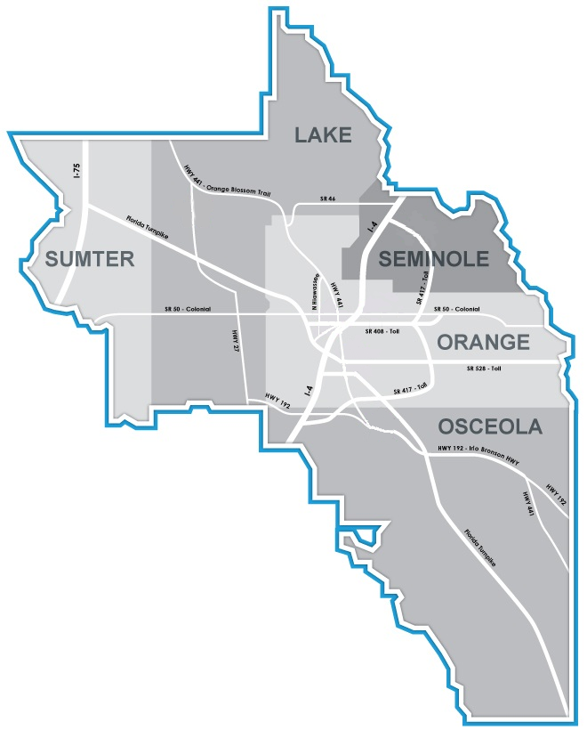
Facilities
(1) Lake (Lake Sumter SC)
Total Square Foot | 11,669
Annual Rental Cost | $169,666
Expiration Date | 1/23/2024
(2) Seminole
Total Square Foot | 10,031
Annual Rental Cost | $176,822
Expiration Date | 6/30/2026
1
2
(3) West Orange
Total Square Foot | 12,041
Annual Rental Cost | $313,846
Expiration Date | 07/31/2026
3
5
6
(4) Osceola
Total Square Foot | 12,731
Annual Rental Cost | $190,965
Expiration Date | 12/31/2024
4
(5) Administration
Total Square Foot | 11,792
Annual Rental Cost | $422,276
Expiration Date | 7/31/2026
(6) Southeast Orange
Total Square Foot | 12,363
Annual Rental Cost | $197,808
Expiration Date | 9/30/2024
Rent / Related cost for maintaining locations represents approximately 6.2% of total rent

Slide 35
G&A PROFESSIONAL SERVICES
$450K
$200K
Accounting / External Monitoring
Payroll & Broker Fees
$150K
Benefit Broker Fees and Third-party Payroll Services
Legal
External Financial Audit Fees and Third-party Financial Monitoring
General Counsel Fees and Employment Law Support
$100K

Slide 36
SUMMARY & BUDGET ASSUMPTIONS
Fiscal Responsibility
Total Funding Revenue $44M; Year-over-Year $2M or 4.8% increase
81.3% Earmarked to Deliver Talent Solutions; 18.7% in General Support Cost
92.2% Is Allocated To Direct Program Cost; 7.8% in Administrative Cost
The proposed budget for salaries will reflect a 4% merit increase average overall. Merit increases are awarded based upon achievement of annual performance goals.
Employee health benefits reflects an increase of 2% of current cost based on market rate, with minimal impact to employee costs or plan structure for the program year.
The total amount budgeted for administrative cost will be to not exceed 8%, lower than the state allowable cap of 10%.

Slide 37
THANK YOU!

