Slide 1
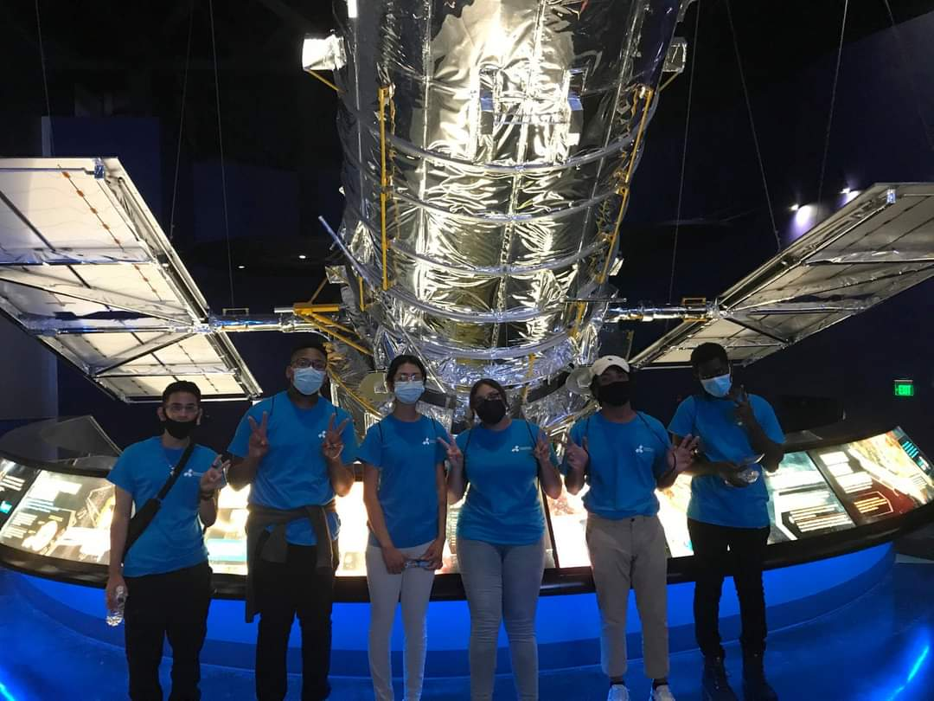
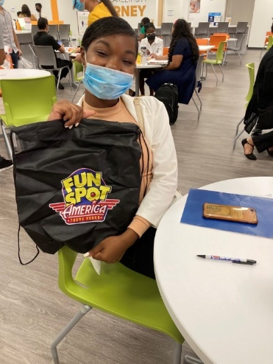
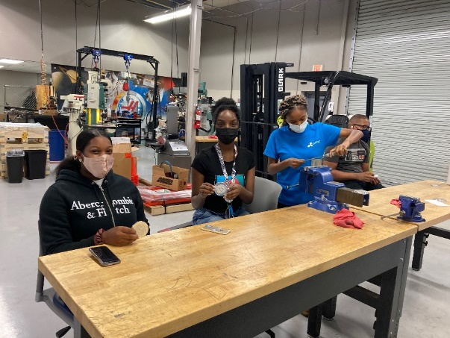
2023 Summer Youth Program
Programming Request for Proposals Bidders’ Conference
https://www.careersourcecentralflorida.com/about-us/work-with-us/

Slide 2
Mission & Goals
Provide 5 Counties of youth aged 15 – 19 with exposure to a variety of career options and ensuing pathways to succeed
Assist at least 1,500 young adults into better understanding what career field they want to enter
Provide opportunity youth the skills and remove barriers to succeed in pursuing a career of interest
Create a robust pipeline of skilled, poised young talent for regional businesses to hire
Position CareerSource CFL as the preeminent and trusted career resources hub in the region

Slide 3
Refreshed Overall Offering
Streamlined application and on-going support of applicants as well as selected participants
Track selection and programming emphasizes where a young adult is in their career desires/understanding vs. pay
Age agnostic track selection
New week-long power skills curriculum to kick-off each track hosted by CSCF
More connectivity to CSCF for participants post their Summer Youth Program engagement
Notes:
Still get paid!

Slide 4
Workforce Readiness Academy
CSCF hosted
Mandatory week-long kick-off program ahead of each track
Covers power skills with role playing and leading experts
Participants walk away with resumes, mock interview practice, LinkedIn profiles and other workforce resources
Provided with global pay cards and/or introduction to Manpower depending on track

Slide 5
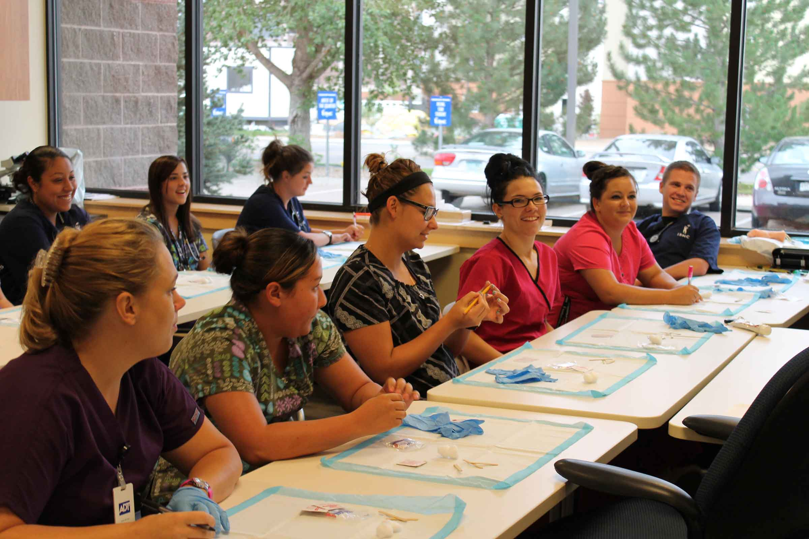


Three-Tiered Approach
EXPLORE
ENGAGE
EXPERIENCE
Field Agnostic
Hosted by post-secondary educational institutions
Field Focused
Hosted by training specialists
Job Focused
Hosted by employers

Slide 6
FY23 Explore Program
For young adults who have “no idea of what they want to be when they grow up”
Share insights on breadth of career choices/industry fields
Offers hands-on projects and classroom activities
Connects participants to career field resources and networking
Showcase the campus and campus life
Provide critical information on financial aid and other student success aid resources

Slide 7





FY23 Engage Program
For young adults who express an industry cluster of interest, to learn about specific careers inside that field
  Hands-on skill development and portfolio project creation
  Networking with and/or potential field trips to workplaces
  Exposure to necessary industry requirements and/or tools
  Fields of potential engagement include (but not limited to):
CONSTRUCTION
STEM
HOSPITALITY
MANUFACTURING
HEALTHCARE

Slide 8
Growth Plan
 | 2022 Actuals* | 2023 Goals
EXPLORE | 175 | 600
ENGAGE (ACCELERATE) | 181 | 400
EXPERIENCE | 607 | 500*
TOTALS | 963 | 1,500*

Slide 9
New Programming Partner Requirements
RFP revamped with clear expectations and explanations of offerings, outcomes and participant engagement
Explore and Engage programmatic partners must provide immersive career experiences
Explore and Engage programmatic partners must provide connectivity to relevant educational/certification pathways
Explore must provide a cost leverage, especially sharing potential student outreach opportunities

Slide 10
Expected FY23 Program Calendar
Summer A Term
CSCF Program (for Explore and Engage):
May 30, 2023 – June 2, 2023
Program Hosts:
June 5, 2023 – June 30, 2023
Summer B Term
CSCF Program (for Explore and Engage):
June 26, 2023 – June 30, 2023
Program Hosts:
July 10, 2023 – August 4, 2023

Slide 11
Request for Proposals
Specifics

Slide 12
Main Highlights of Explore vs. Engage
Expected Outcomes
 | OUTCOMES
EXPLORE | Participants can identify a career cluster of further interest Participants understand the time, financial, and other resource commitments required to succeed @ educational institution Participants have career/education questions answered
ENGAGE | Participants able to ID the necessary resources for the field Participants hone their skills and gain new aptitude levels Participants learn the ability to network with professionals Participants have portfolio examples of their own Participants can articulate what about the career cluster/field was not appealing to them

Slide 13
Main Highlights of Explore vs. Engage
Eligible Organizations
 | Eligible Orgs
EXPLORE | Accredited educational institutions
ENGAGE | 501c3 nonprofit organizations For-profit organizations Educational institutions 501c6 consortiums

Slide 14
Explore Expected Deliverables
Comprehensive presentation of a number of locally accessible industries/career clusters to young adults unsure of what career path they wish to pursue
Career exposure experiences
Career collateral and other resources
Networking opportunities
Hands-on skill development
Workplace environment immersions
Presentations or collateral resources on which degrees and/or certifications best position prospective workers into these careers.

Slide 15
Engage Expected Deliverables
Field-specific skill development
Perspectives from subject matter experts describing their ‘day-in-the-job’ of that field
Perspectives from potential students pursuing educational pathways related to these fields
Immersive experiences relating to the typical work environment of that industry field (i.e. remote work with individual responsibilities, versus in-person, team dynamics work, versus individual skill development in a commercial kitchen, etc.)
Critical industry certification/education information
Tools and/or collateral outlining the necessary tools for them to thrive
Continued skill exercises/development for ‘after-hours’ or even beyond the conclusion of the program
Any other information/resources deemed necessary for a deeper understanding of what a pursuit of these careers require.

Slide 16
Explore Cost Leverage
This leverage is at least 20% of the total proposed cost estimate
Cash or in-kind allowed
Ideas include:
Marketing budget
Classroom/lab supplies
Staff time
Transportation vehicles/staffing
Other on-campus resources (i.e. facilities, dining, collateral print, etc.)

Slide 17
RFP Required Documents
Cover Letter (only need one)
Scope Narrative
Budget
Relationship Disclosure Form
Contractor Provisions, Certifications and Assurances

Slide 18
Required Document - Narrative
Multiple proposals per program are welcome, especially in Engage
Explore and Engage Narratives differ in template
Be as thorough as possible, but 10 page limit
Address each major question/header
12-point font, single spaced narratives

Slide 19
Scope Narrative - Explore
NAME OF PROPOSED EXPLORE PROGRAM:
INDUSTRY FIELD/CAREER CLUSTER AREA(S) COVERED IN PROPOSED PROGRAM:
HOST ORGANIZATION(S):
CSCF FY23 PREFERRED TIMEFRAME SELECTION(S): (Summer A, B, or Both)
PREFERRED COUNTY(IES) TO HOST EXPLORE PROGRAM WITHIN: (Share as many as you could host this particular program within: Lake, Orange, Osceola, Seminole and/or Sumter)
POTENTIAL SITE(S) WHERE PROPOSED EXPLORE MAY BE HOSTED: (Provide facility name and address at minimum. Brief information shared on building access, parking and any other facility-related issues being resolved as soon as possible will strengthen the proposal).

Slide 20
Scope Narrative – Explore (cont.)
7. BACKGROUND AND HISTORICAL IMPACT (IF AVAILABLE) OF ORGANIZATION IN YOUTH CAREER PROGRAM HOSTING – ALSO SHARE ORGANIZATION’S MARKETING/OUTREACH DEPARTMENT WEBSITE AND/OR OTHER COLLATERAL
8. BRIEFLY SUMMARIZE AT LEAST FOUR OR MORE INDUSTRIES/CAREER CLUSTERS THAT WILL BE FEATURED IN THE PROPOSED PROGRAM:
9. LIST ANY INDUSTRY CONNECTING INITAITIVES/ASSETS CURRENTLY AT THE ORGANIZATION SUPPORTING CURRICULUM AND/OR STUDENT CAREER SUCCESS OVERALL (i.e. INDUSTRY ADVISORY BOARDS, PROFESSIONAL ORGANIZATION CONNECTIONS, ALUMNI CONNECTIONS, etc.)
10. PROPOSED CURRICULUM AND RESOURCE OFFERINGS SUMMARY FOR THIS EXPLORE PROGRAM:

Slide 21
Scope Narrative – Explore (cont.)
11. LIST AND/DESCRIBE EXAMPLES OF CAREER-CENTRIC CONTACTS AND/OR RESOURCES TO BE PROVIDED IN PROPOSED EXPLORE PROGRAM:
12. LIST AND/DESCRIBE EXAMPLES OF INTERNAL INSTITUTION DEPARTMENTS/RESOURCES PARTICIPANTS WILL BE EXPOSED TO, FOR A BETTER UNDERSTANDING OF CAMPUS LIFE/EDUCATION PURSUIT:
13. PROVIDE A DRAFT ITINERARY: (provide rough estimates of daily timeframes and potential skills, topics and/or other resources presented during the Explore Program)
14. DESCRIBE YOUR COST LEVERAGE – CASH/IN-KIND, ITS SOURCES AND WHAT PART OF THE PROPOSED PROGRAM IT WILL SUPPORT/WHAT IT LEVERAGES, etc.:
15. DESCRIBE HOW YOU WILL ADDRESS THE DESIRED EXPLORE OUTCOMES AND HOW YOU WOULD MEASURE/COLLECT THESE OUTCOMES (see SECTION 2.0)
16. OTHER INFORMATION CSCF SHOULD KNOW ABOUT THE PROPOSED EXPLORE PROGRAM

Slide 22
Scope Narrative - Engage
NAME OF PROPOSED ENGAGE PROGRAM:
INDUSTRY FIELD/CAREER CLUSTER AREA(S) COVERED IN PROPOSED PROGRAM:
HOST ORGANIZATION(S):
CSCF FY23 PREFERRED TIMEFRAME SELECTION(S): (Summer A, B, or Both)
5. PREFERRED COUNTY(IES) TO HOST ENGAGE PROGRAM WITHIN: (Share as many as you could host this particular program within: Lake, Orange, Osceola, Seminole and/or Sumter)
6. POTENTIAL SITE(S) WHERE PROPOSED ENGAGE MAY BE HOSTED: (Provide facility name and address at minimum. Brief information shared on building access, parking and any other facility-related issues being resolved as soon as possible will strengthen the proposal).

Slide 23
Scope Narrative – Engage (cont.)
7. BACKGROUND AND HISTORICAL IMPACT (IF AVAILABLE) OF ORGANIZATION WITHIN THIS FIELD AND/OR YOUTH CAREER PROGRAM HOSTING:
8. PROPOSED CURRICULUM AND RESOURCE OFFERINGS SUMMARY FOR THIS ENGAGE PROGRAM:
9. LIST RELEVANT INDUSTRY CERTIFICATIONS/TRAINING TO BE PROVIDED IN PROPOSED ENGAGE PROGRAM:
10. LIST AND/DESCRIBE EMPLOYER ENGAGEMENT OFFERINGS, SUCH AS INDUSTRY SPECIFIC CONTACTS AND/OR RESOURCES TO BE PROVIDED IN PROPOSED ENGAGE PROGRAM:

Slide 24
Scope Narrative – Engage (cont.)
11. PROVIDE A DRAFT ITINERARY: (provide rough estimates of daily timeframes and potential skills, topics and/or other resources presented during the Engage Program)
12. SHARE BRIEF BACKGROUNDS ON POTENTIAL TRAINERS FOR PROPOSED ENGAGE PROGRAM:
13. DESCRIBE HOW YOU WILL ADDRESS THE DESIRED ENGAGE OUTCOMES AND HOW YOU WOULD MEASURE/COLLECT THESE OUTCOMES (see SECTION 2.0)
14. OTHER INFORMATION CSCF SHOULD KNOW ABOUT THE PROPOSED ENGAGE PROGRAM

Slide 25
Budget Template
Must submit a Budget PER Narrative:
Costs can include:
  Staffing;
  Curriculum development or coordination;
  Industry-focused, leadership, employability, and exploration activities;
  Participant supplies and materials;
  Administrative and facility/transportation costs (if applicable);
  Other direct costs

Slide 26
Budget Template (cont.)

Slide 27
Explore Evaluation
Explore Criteria | Details | Max Points
Quality of Proposal | Proposal displays various career exposure activities Proposal displays at least three other programmatic elements requested in Scope Adherence to proposal format Proposal displays clearly articulated opportunities and activities for participants to understand student success resources, culture, etc. | 35
Cost/Scope Template | Total Cost of Program competitiveness Cost per Participant competitiveness Expenses clearly explained and are within reason Provides at least 20% cost leverage in Scope and Budget Uniqueness and effective tie-ins of leveraged resources towards cost leverage | 20

Slide 28
Explore Evaluation (cont.)
Explore Criteria | Details | Max Points
Capacity/Ability | Quality and quantity of industry connections/alumni data/etc. supports clear indication for participants to understand career Proposal displays the respondent successfully recruits students to the institution as well as successful student graduate/placement Proposer has adequate, appropriate facilities available for the proposed maximum number of participants Proposer demonstrates a competent, relevant staff base capable of implementing the program | 35
Additional Offerings | Executive guest speakers within the program Tours of the targeted industries Demonstration within these offerings of participants being able to network with subject matter experts and have questions they may have about careers and/or the educational institution thoroughly answered | 20
Proposer is a Minority or Woman-Owned Business |  | 5*
TOTAL POINTS AWARDED PER PROPOSAL |  | 100*
Notes:
* Bonus points could bring the score to 105 total points

Slide 29
Engage Evaluation
Engage Criteria | Details | Max Points
Quality of Proposal | Proposal displays various, appropriate training activities to participants Proposal displays at least two other programmatic elements requested in Scope that provides additional exposure to the industry focus area Proposal confirms participants will deploy portfolio development opportunities by the conclusion of the program Proposer describes a clear assessment path from pre- to post-program demonstrating skill gains by each participant Adherence to Proposal format | 35
Cost/Scope Template | Total Cost of Program competitiveness Cost per Participant competitiveness Demonstrates unique and/or strong leveraging of existing resources to provide a strong programmatic proposal | 25

Slide 30
Engage Evaluation (cont.)
Engage Criteria | Details | Max Points
Capacity/Ability | Demonstrates connectivity to industry resources and/or experts in relevant industry field/career clusters Demonstrates an impactful history of the organization’s success in training young adults through skill acquisition Shares clear impact metrics for certification and/or other training deliverance to previous participants Background information on training and other organization staff demonstrates the necessary expertise | 25
Additional Offerings | Executive guest speakers within the program Tours of the targeted industries Demonstration of participants being able to network Provision of necessary tools, software, and/or other resources for participants to build upon within that industry field/career cluster | 15
Proposer is a Minority or Woman-Owned Business |  | 5*
TOTAL POINTS AWARDED PER PROPOSAL |  | 100*
Notes:
* Bonus points could bring the score to 105 total points

Slide 31
RFP Calendar
Date | Activities/Events
10/3/2022 | RFP Launched
10/10/22 | Bidder Conference
10/21/22 | Final Clarifying/Technical inquiries concerning the RFP must be received by 5:00pm EST, via email at publicresponse@careersourcecf.com. Please type “INQUIRY – SYP-E&E-PY23” in the subject line. Response to all inquiries will be made available on the CSCF’s Solicitation Requests website within 3 days at Work With Us - CareerSource Central Florida
11/2/2022 | Electronic RFP responses are to be submitted by email in PDF format version. Proposals must be received by 5:00 PM EST.
11/3/2022 | Bids will be opened privately on November 3, 2022 and Proposers will be notified as to successful bidder(s) once the review process and negotiations are complete.
11/4/2022-11/11/2022 | Proposal review by review team, date to be confirmed
12/15/2022 | Scheduled on Full Board of Directors agenda for approvals
1/6/2023 | Contract negotiations and final contracts drafted by 1/6/2023

Slide 32
Q&A

Slide 33
Thank you!
Please send all questions to:
publicresponse@careersourcecf.com
By October 21 @ 5PM

Slide 34
Backup Slides

Slide 35
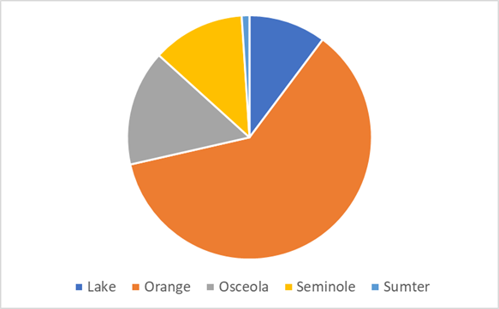
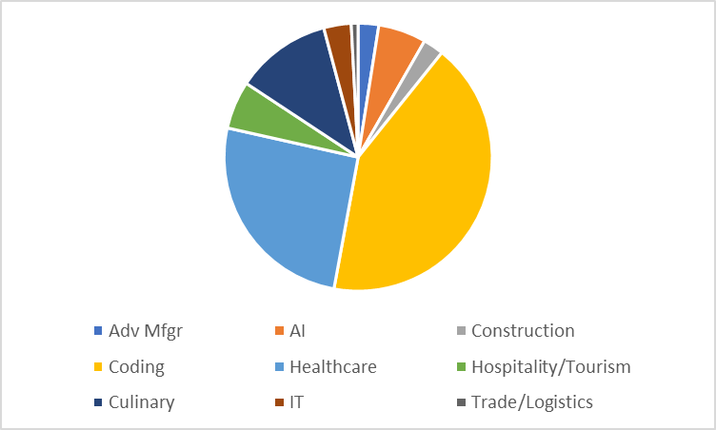
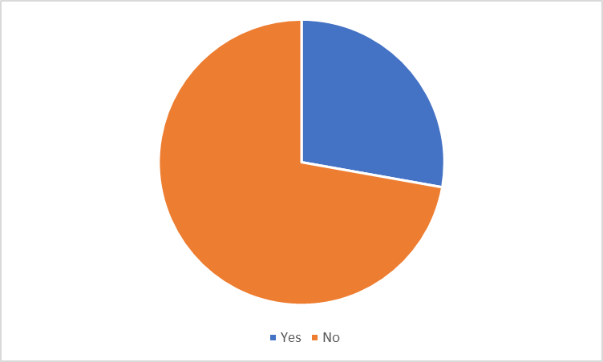
FY22 Participant Preference Data
LOCATION BREAKDOWN
FIELDS/INDUSTRIES OF INTEREST
REPEAT PARTICIPANTS
*From CareerEdge

Slide 36
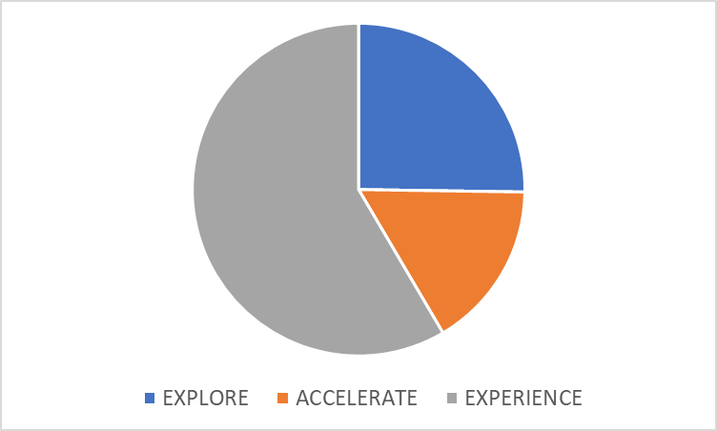
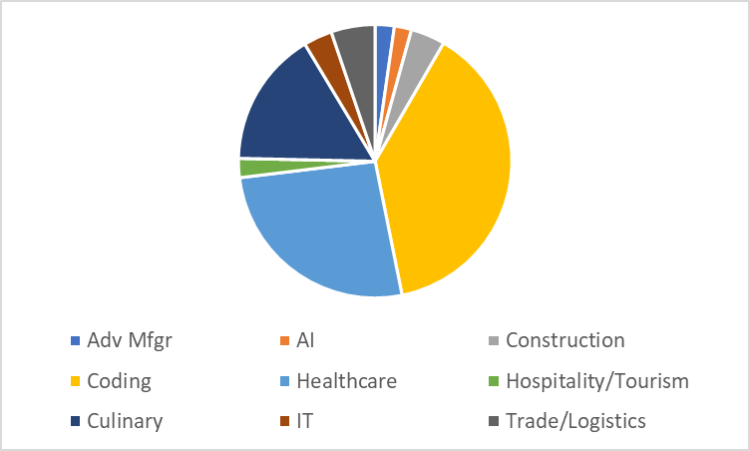
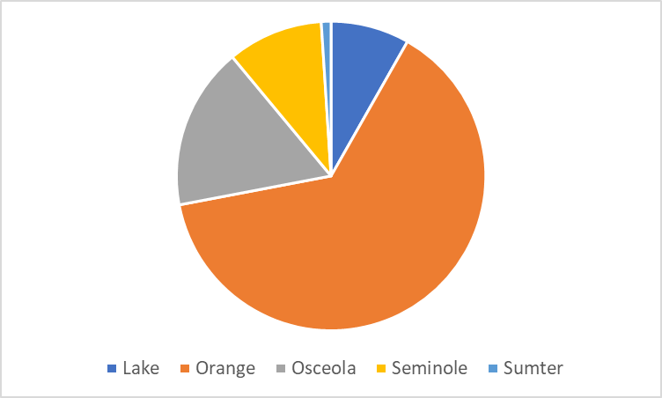
FY22 Applicant Preference Data
*From CareerEdge

Slide 37
CSCF’s Commitment
Funding/fundraising for programming partners
Stipends to participants
Outreach (both in-person at schools as well as online – paid and un-paid)
Select participants and host a waiting list; onboard
Operational support staff to work with the participants
Host the first week of every program
Online or analog monitoring materials

