Slide 1
Manpower & CareerSource Central FL 2023 Summer Youth Program Orientation

Slide 2
Zenaida “Zeny” Marrero
Zenaida.Marrero@Manpower.com
407-702-2240
Becky Graham
Becky.Graham@Manpower.com
386-888-3787
2432 Sand Lake Road, Orlando, FL 32809
Office Hours: Monday-Friday/ 8AM - 5PM *Please leave a voicemail if not available.
Summer Youth Orientation
RESOURCES
Manpower Associate Care Center (MACC):
For questions about your paycheck or if you need assistance with entering your time worked, please call 1-800-561-6934.
Careersource Central Florida Contact Info
407-531-1222
800-757-4598

Slide 3
Summer Youth Orientation
TIME ENTRY GUIDELINES
Summer Youth interns do not qualify for holiday or paid time off. Do not enter hours for dates that you did not actually work.
We encourage you to submit your hours on the last day that you work each week. Timesheets must be entered no later than SUNDAY @ MIDNIGHT to avoid delay in pay.
Lunch breaks are unpaid and must be recorded under “Lunch In/Out” when entering your time.
If the hours submitted in PeopleNet are not accurate, the site supervisor will reject your timesheet. You will be responsible for correcting and re-submitting on the PeopleNet website ASAP.
Manpower is your employer.
Please do not go to your Manager at your intern site if you have any issues with timesheets/checks, or questions about your W2.
Instead, please contact the Manpower Associate Care Center (MACC) at:
1-800-561-6934

Slide 4
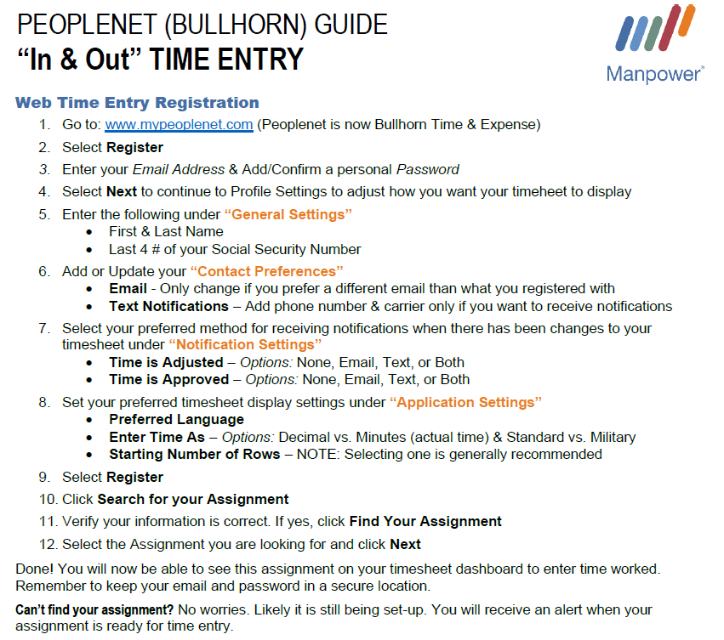
TIME ENTRY- PEOPLENET REGISTRATION
Can't find your assignment? Don't worry! Your assignment should show in PeopleNet before the end of your first week of work. If not, please call Zeny or Becky with Manpower immediately.
Please pay careful attention when registering for PeopleNet-
Your first & last name (including hyphenated or double last names), email address, and last 4 digits of your Social Security # must match exactly what you submitted to Manpower.

Slide 5
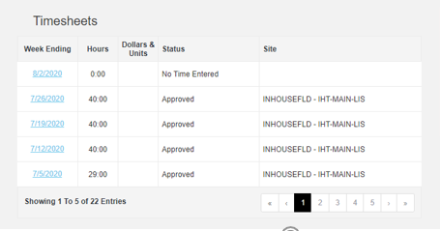
TIME ENTRY- CREATING A TIMESHEET
All Summer Youth participants must enter their own hours.
After Registration- Login to: www.mypeoplenet.com
3. Do not use the App from the App Store. Use the web link
4. Select the week ending date you wish to enter hours for
* Week Ending date will always be a Sunday
5. Click on the cell under the date that you want to enter time for
6. Enter the “In” and “Out” time you worked that day
7. Click on the + Lunch to add unpaid break times (e.g. unpaid lunch break from 12:30pm – 1:00pm)
8. Once finished, entering the entire week, click SUBMIT.

Slide 6
Summer Youth Orientation
WORK SCHEDULE
Individual work schedules will be provided by the internship site supervisor/manager.
Please keep track of your hours worked to ensure that you enter them accurately in PeopleNet.
Summer Youth participants will work up to 30 hours per week. Please notify Zeny/Becky if you have been asked by your site manager to work more hours.

Slide 7
Summer Youth Orientation
ATTENDANCE
If you are late or absent for a scheduled shift, please be sure to contact Zeny/Becky at Manpower AND the Manager at your internship site.
Attendance is closely monitored, and absences/voluntary time off will not extend the pre-determined end date of your internship.
Excessive absences or attendance issues may result in your internship being ended.
If you or your site ends your Summer Internship, it is your responsibility to inform Manpower ASAP.

Slide 8
PAYROLL & PAY DAY
If you have not setup direct deposit already, please do that TODAY:
Call the Manpower Associate Care Center (1-800-561-6934 Option #6) to request an ADP/Wisely Pay Card OR
Open your own checking/savings account, or prepaid debit card account
Payroll is processed every Monday.
Manpower Associates are paid every Friday, beginning with the second week of work.
Federal Taxes will be taken out of each paycheck.
Direct Deposit accounts must have your name as the owner and typically take 7 - 10 days to pre-note and become active.
Please be prepared for your first payment to be a paper check. This check will be mailed to your address on file, from our Corporate office in Wisconsin.
It is important that you keep your mailing address & contact information updated with Manpower.

Slide 9
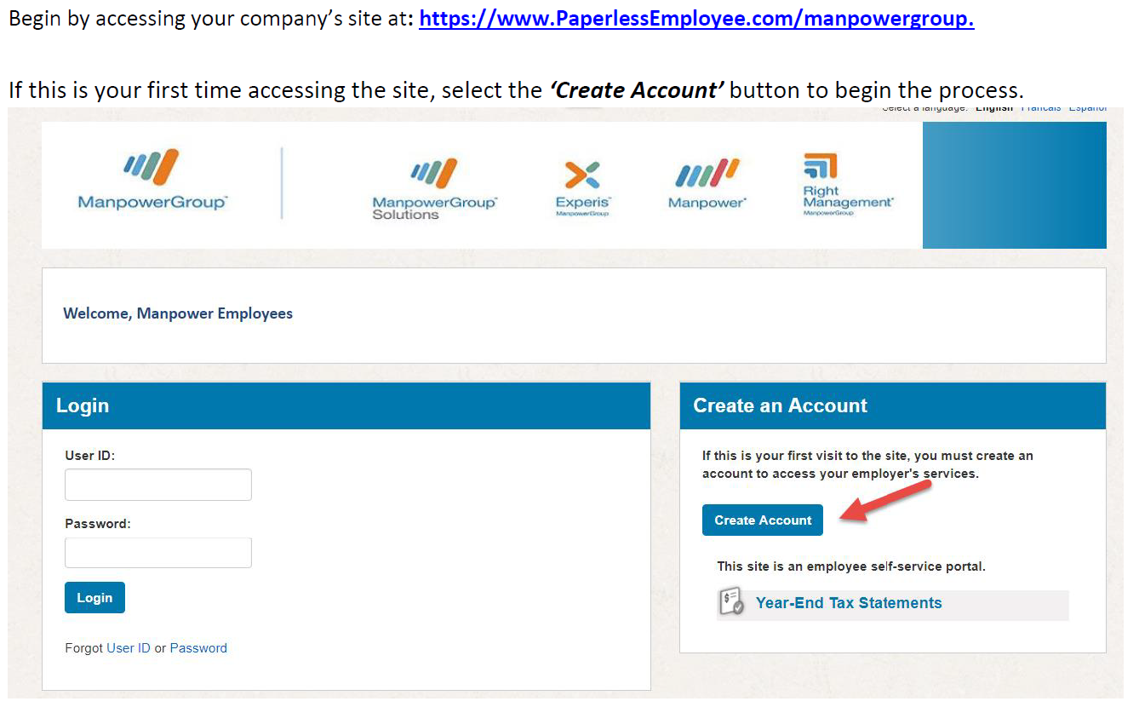
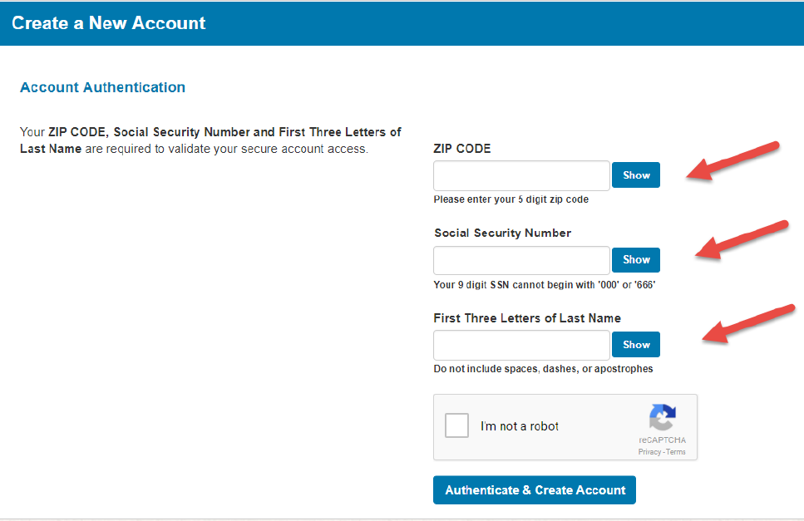
Summer Youth Orientation
ONLINE PAY STUB ACCESS- PAPERLESS EMPLOYEE
Paperless Employee is the website where you will access pay stubs as well as year-end tax documents (W2’s) online.
Best practice is to wait until you receive your 1st pay, to register.
After you select the ‘Create Account’ button you will be directed to the ‘Account Authentication’ screen. Authenticate your identity.
*These details will be compared against the details we have on file for your
employee record with Manpower.
Your first & last name (including hyphenated or double last names), email address, and your Social Security # must match exactly what you submitted to Manpower.
Once you have entered the authentication values on this screen, select the ‘Authenticate & Create Account’ button.

Slide 10
Summer Youth Orientation
REPORTING AN INJURY
AmeriSys is the state’s workers’ compensation provider.
* Call Zeny/Becky immediately to report.
Manpower may instruct you
To report a work- related injury, please call AmeriSys at 1-800-455-2079 and provide the following CODE: 2306
HEALTH & SAFETY
Make sure to follow all safety and health guidelines at your intern site.
Wash your hands regularly and stay home if you are sick.
If you are not reporting to work, please call Zeny/Becky to report it.

Slide 11
Open Discussion & Questions
Once your Manpower onboarding is 100% complete, you will be sent an email from a Manpower Recruiter with the
Subject: You are cleared to start working!
Please do not report to your worksite unless you have the “Cleared to Start” email. Most likely, you have missed a step in the Manpower hiring process and those issues need to be resolved before you can work or be paid.
The email contains:
This Summer Youth PowerPoint presentation
Time Entry/PeopleNet Instructions
Pay Stub/Paperless Employee Instructions
Congratulations on your new role with the Summer Youth Program!
Keep up the good work!

